Slide 1
University Students Social Networking Database

Slide 2
Group Members
SAMPADA DHOLE - 001526241
MEENAKSHI VIJAY KUMBHAR - 002922024
VISHNUPRASAD THOPUCHARLA-002926400
NIKHITHA DASI SRINIVAS- 002922544
SHRAVYA VURA - 002927192

Slide 3
Problem Statement
As the teaching method has changed from traditional on ground classes to Online classes, It has become difficult for students to interact with their fellow-mates.
We come across fake profiles due to which people get affected personally and professionally.
Difficulty in maintaining security.

Slide 4
Objective
Establish a verified student network database with other graduate students, so they can get in touch based on the coursework they have chosen and have a wide range of student networks who can help each other for the betterment of their career growth
Resolve the security issues caused mainly due to fake identification of profiles and provide a safe and interactive environment for students to network and discuss both course related topics and build networking based on personal interests.

Slide 5
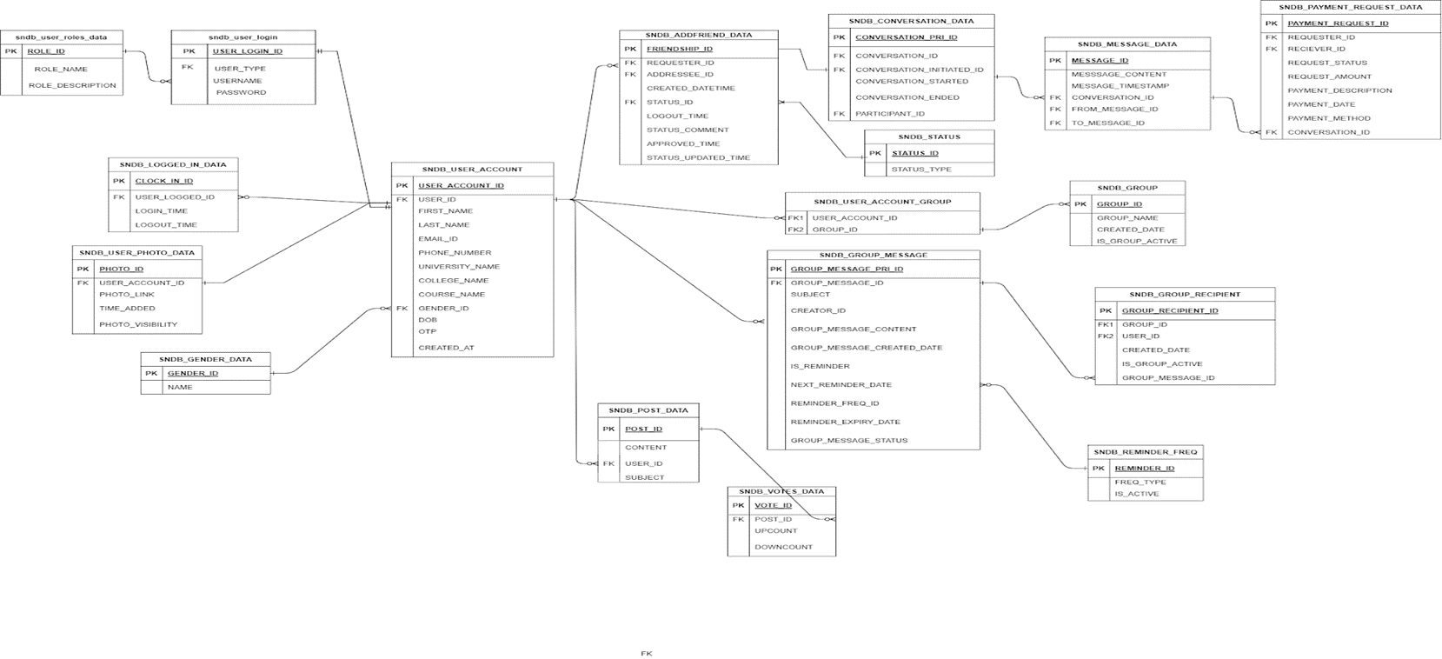
ER Diagram

Slide 6
Concepts Implemented
TABLES
PROCEDURES
PACKAGES
INDEXES
TRIGGERS
CURSORS
FUNCTIONS
VIEWS
REPORTS

Slide 7
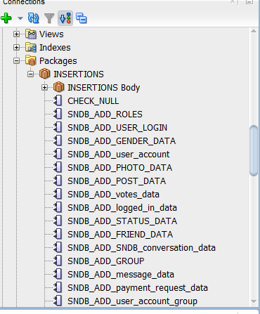
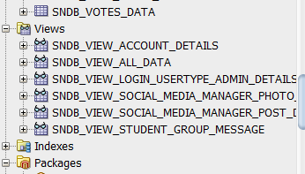
DB OBJECTS

Slide 8
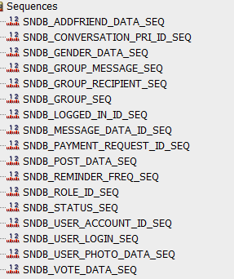
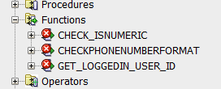
DB OBJECTS

Slide 9
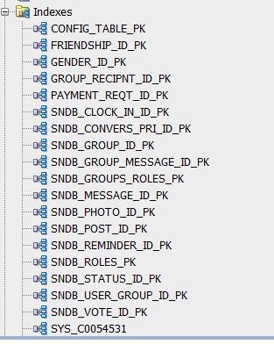
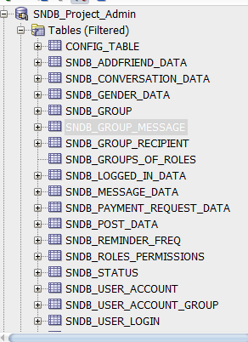
DB OBJECTS

Slide 10
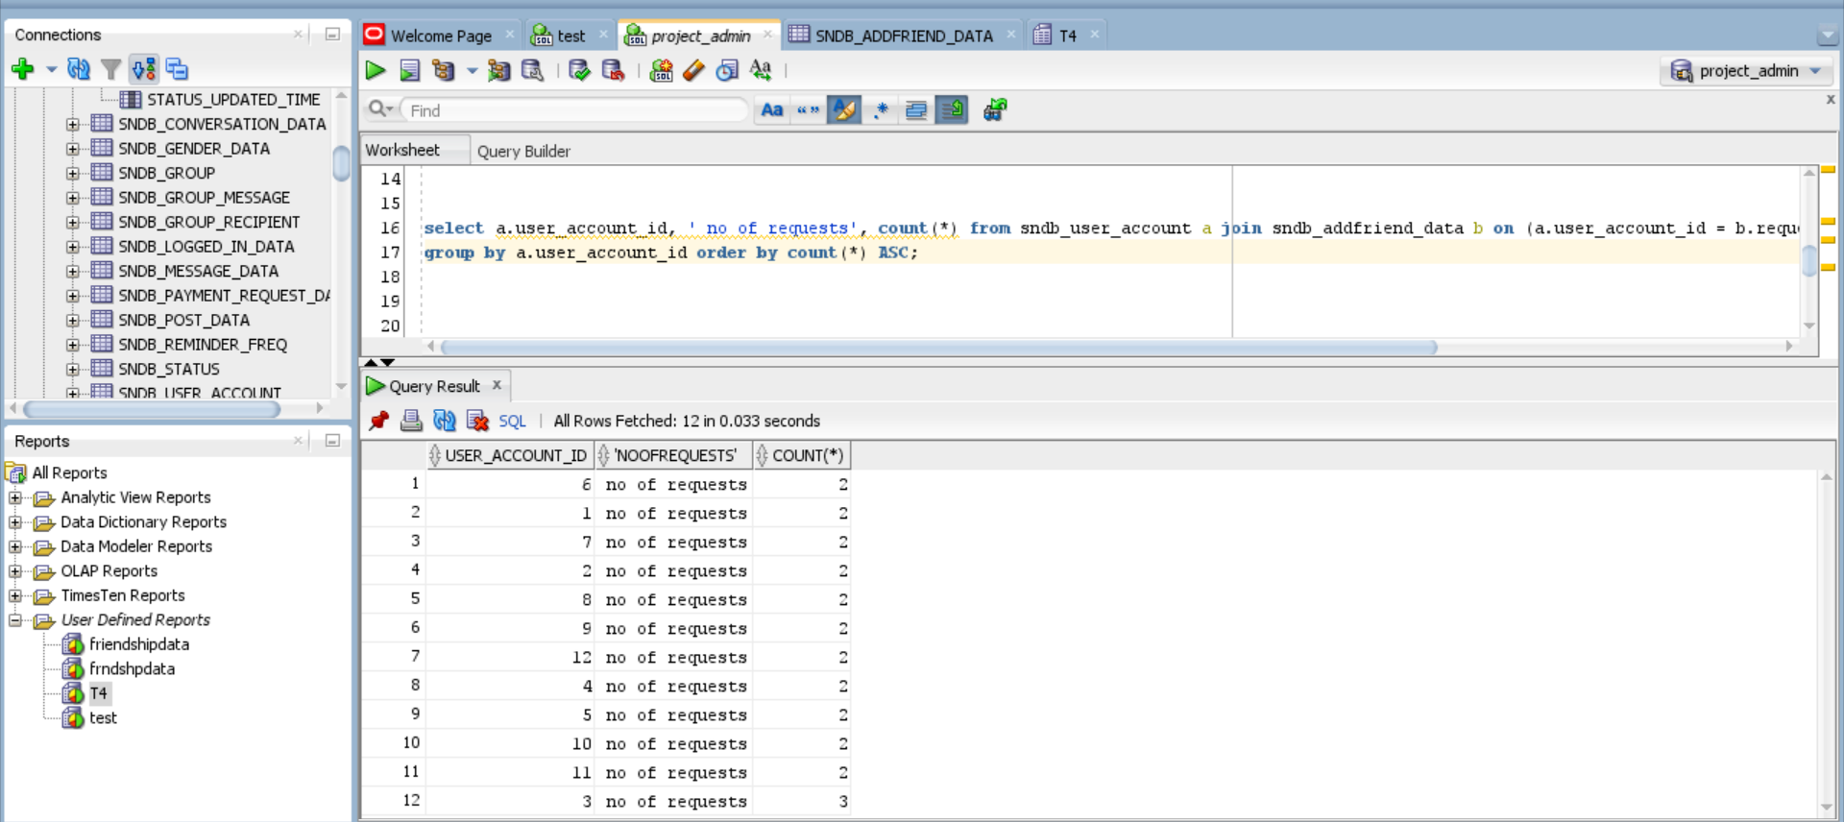
REPORTS
NO OF FRIEND REQUESTS:
select a.user_account_id, ' no of requests', count(*) from sndb_user_account a join sndb_addfriend_data b on (a.user_account_id = b.requester_id or a.user_account_id = b.addressee_id)
group by a.user_account_id order by count(*) ASC;

Slide 11
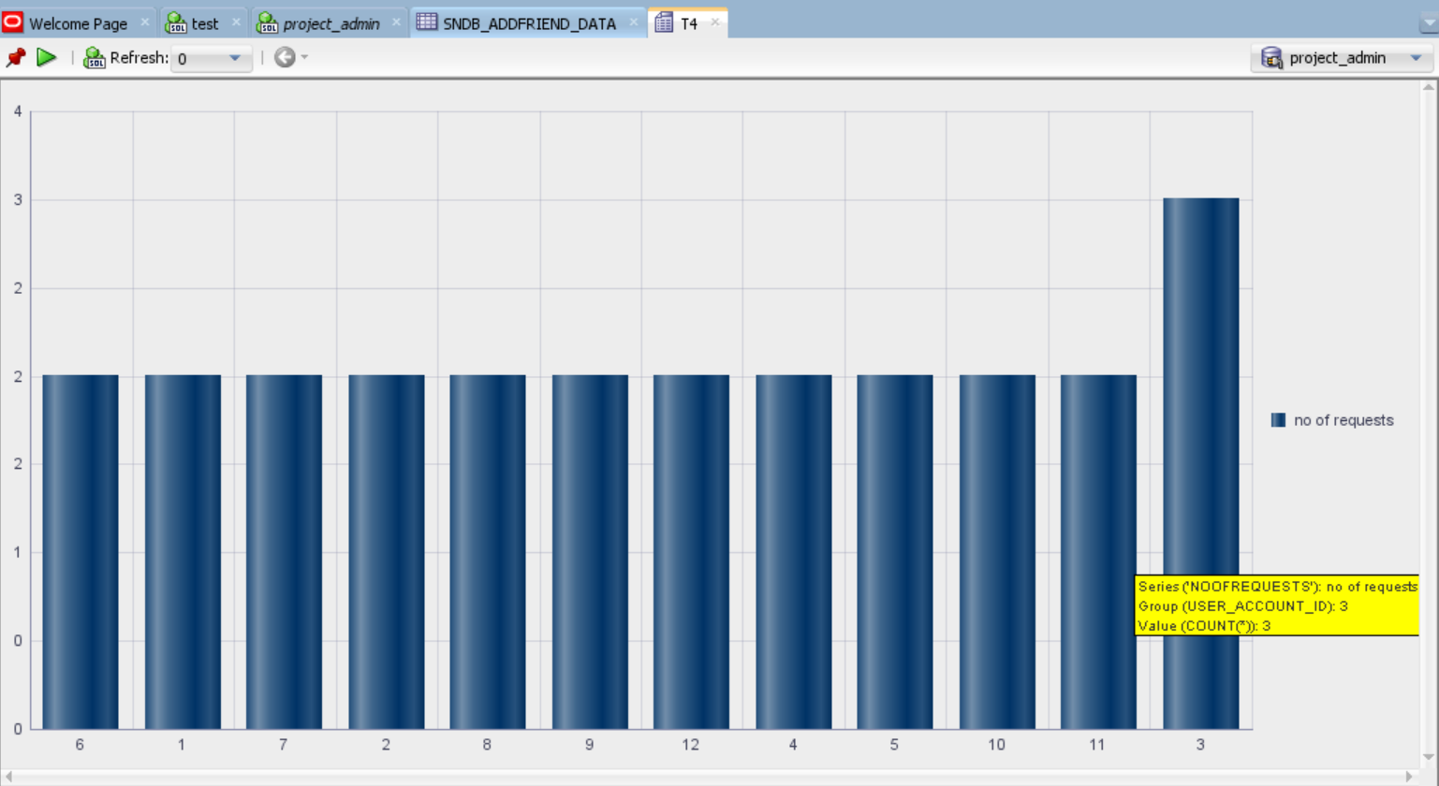

Slide 12
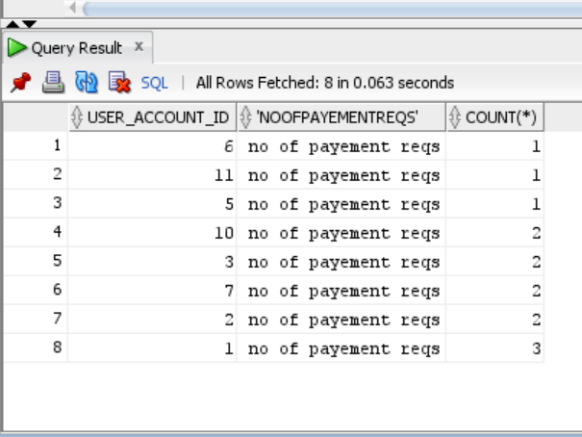
NO OF PAYMENT REQUESTS:
select a.user_account_id, ' no of payment reqs', count(*) from sndb_user_account a join sndb_payment_request_data b on (a.user_account_id = b.requester_id or a.user_account_id = b.reciever_id)
group by a.user_account_id order by count(*) ASC;

Slide 13
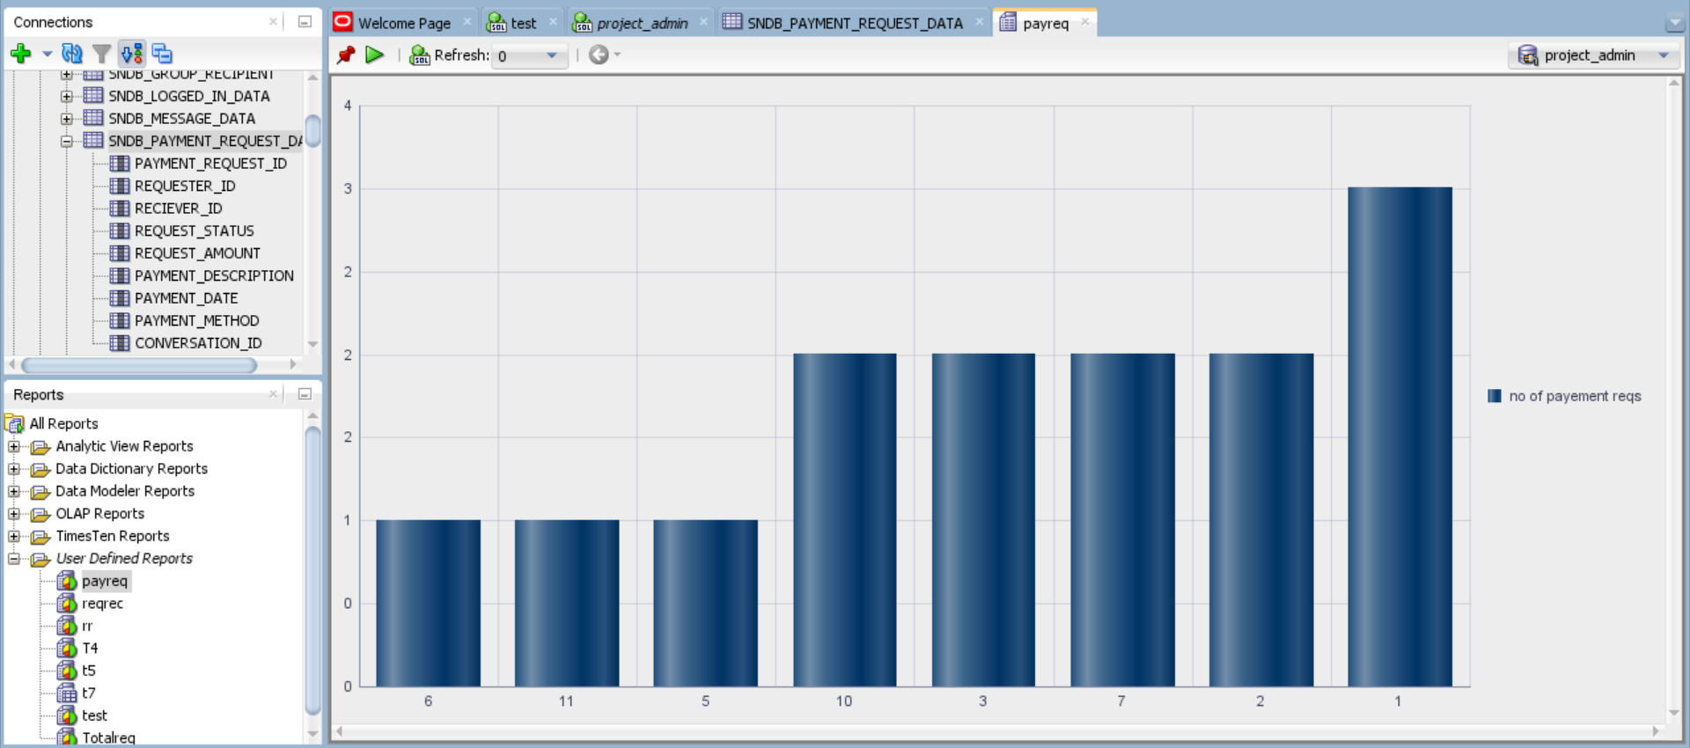

Slide 14
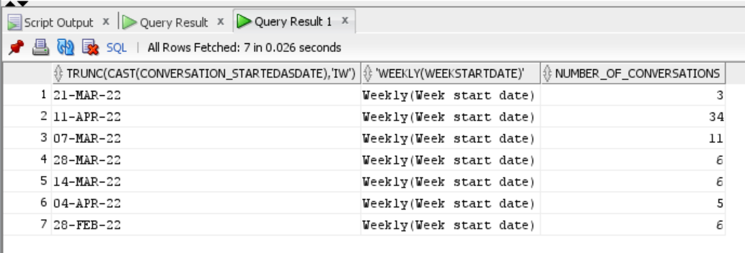
NO OF CONVERSATIONS:
Select TRUNC(cast(conversation_started as date),'IW') , 'Weekly(Week start date)', count(*)
as Number_of_conversations from sndb_conversation_data group by TRUNC(cast(conversation_started as date),'IW')

Slide 15
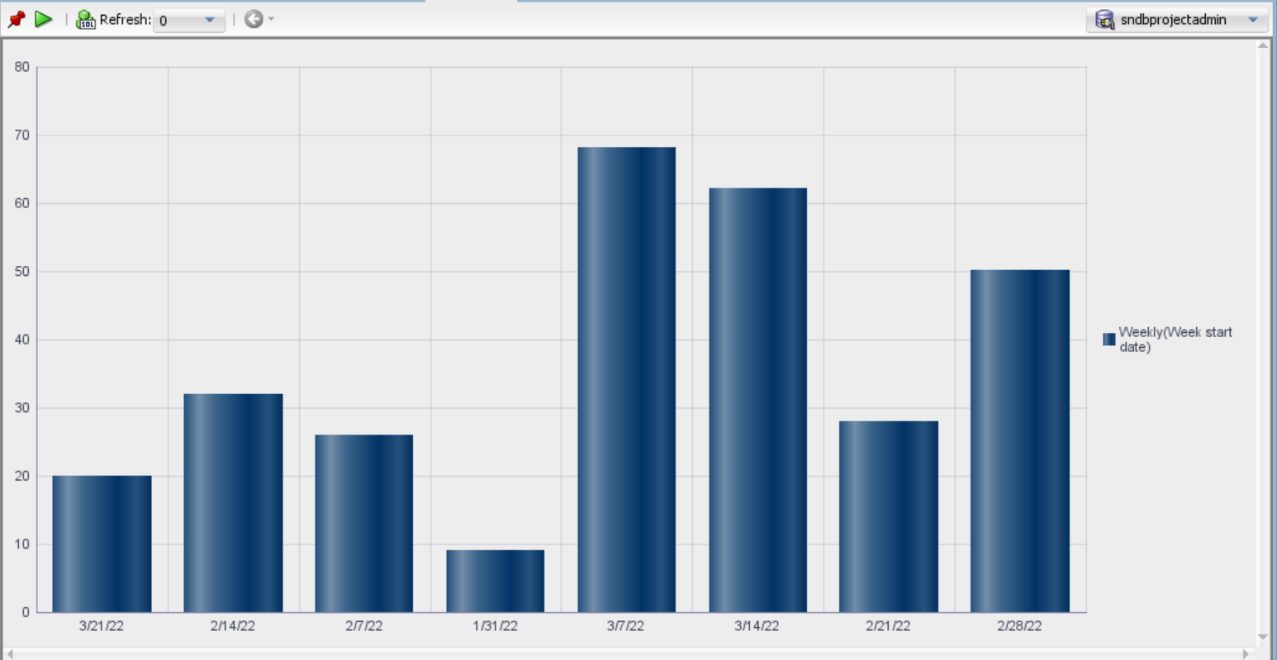

Slide 16
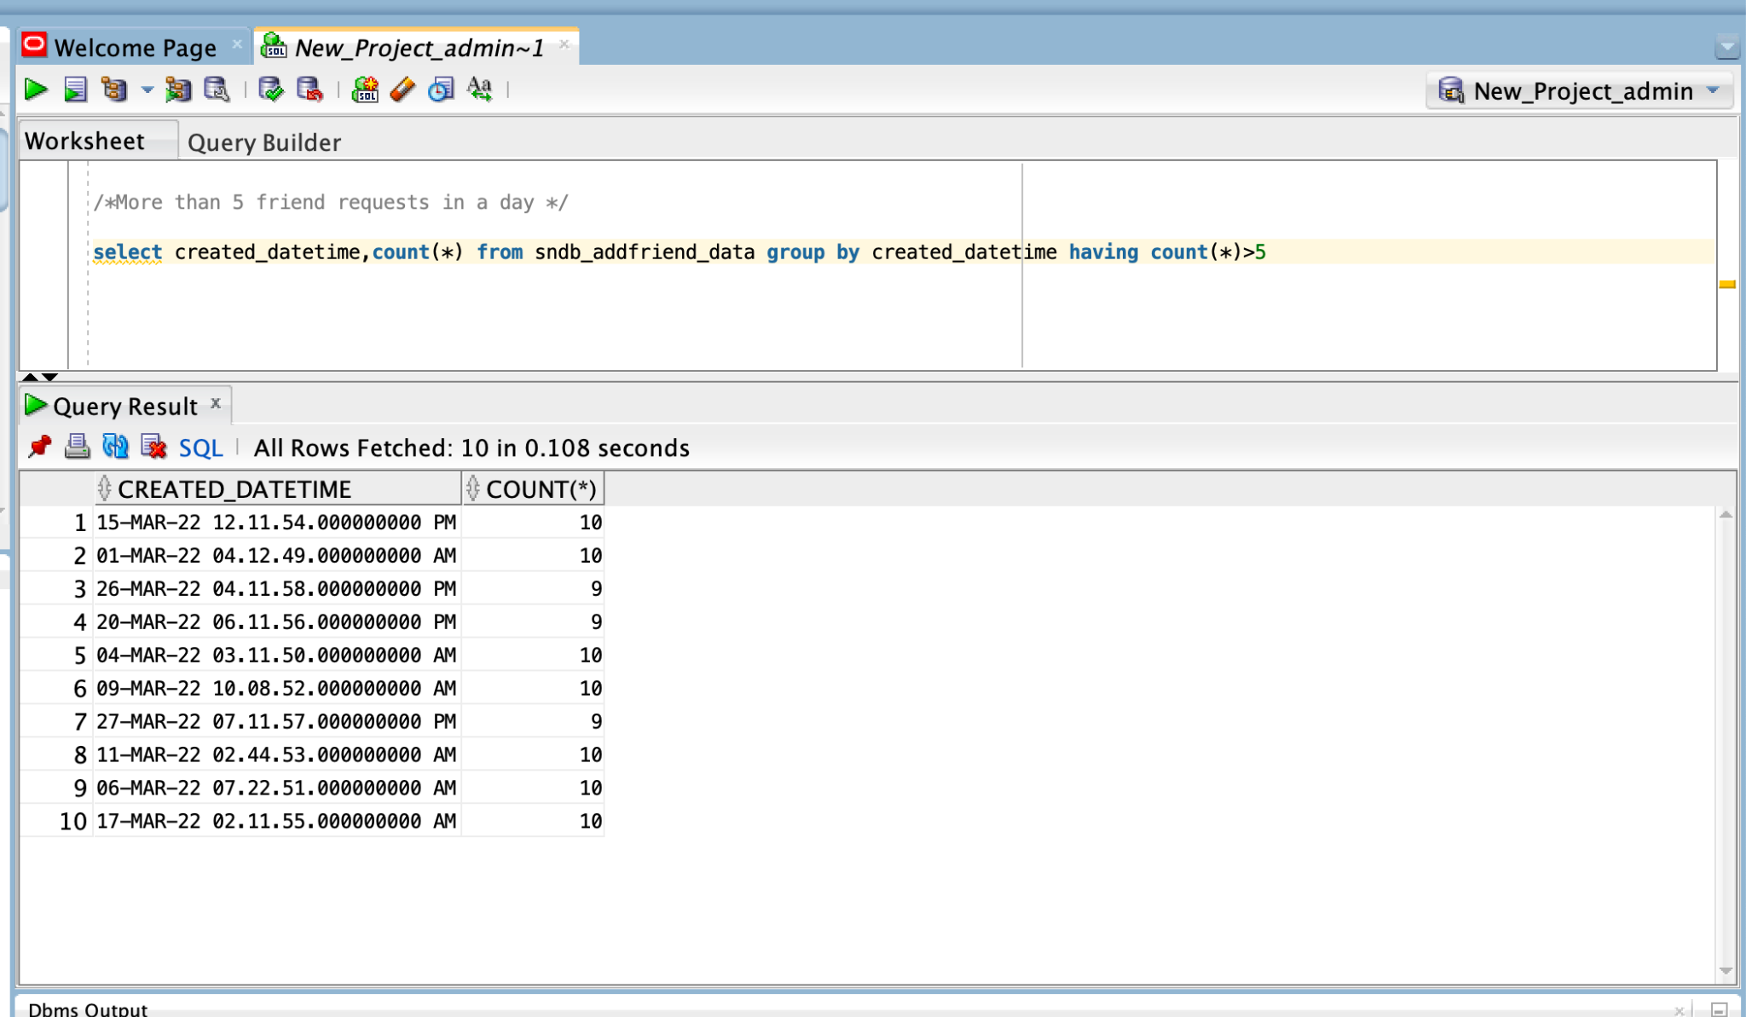
More than 5 friend requests in a day:
select created_datetime,count(*) from sndb_addfriend_data group by created_datetime having count(*)>5

Slide 17
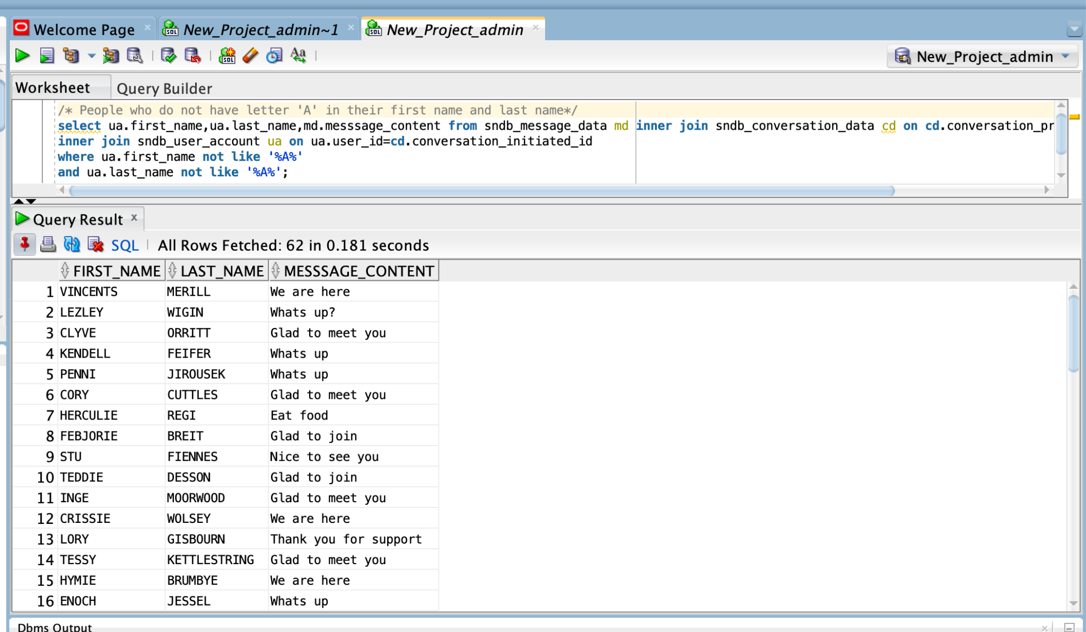
People who do not have letter 'A' in their first name and last name
select ua.first_name,ua.last_name,md.messsage_content from sndb_message_data md inner join sndb_conversation_data cd on cd.conversation_pri_id=md.conversation_id
inner join sndb_user_account ua on ua.user_id=cd.conversation_initiated_id
where ua.first_name not like '%A%'
and ua.last_name not like '%A%';

Slide 18
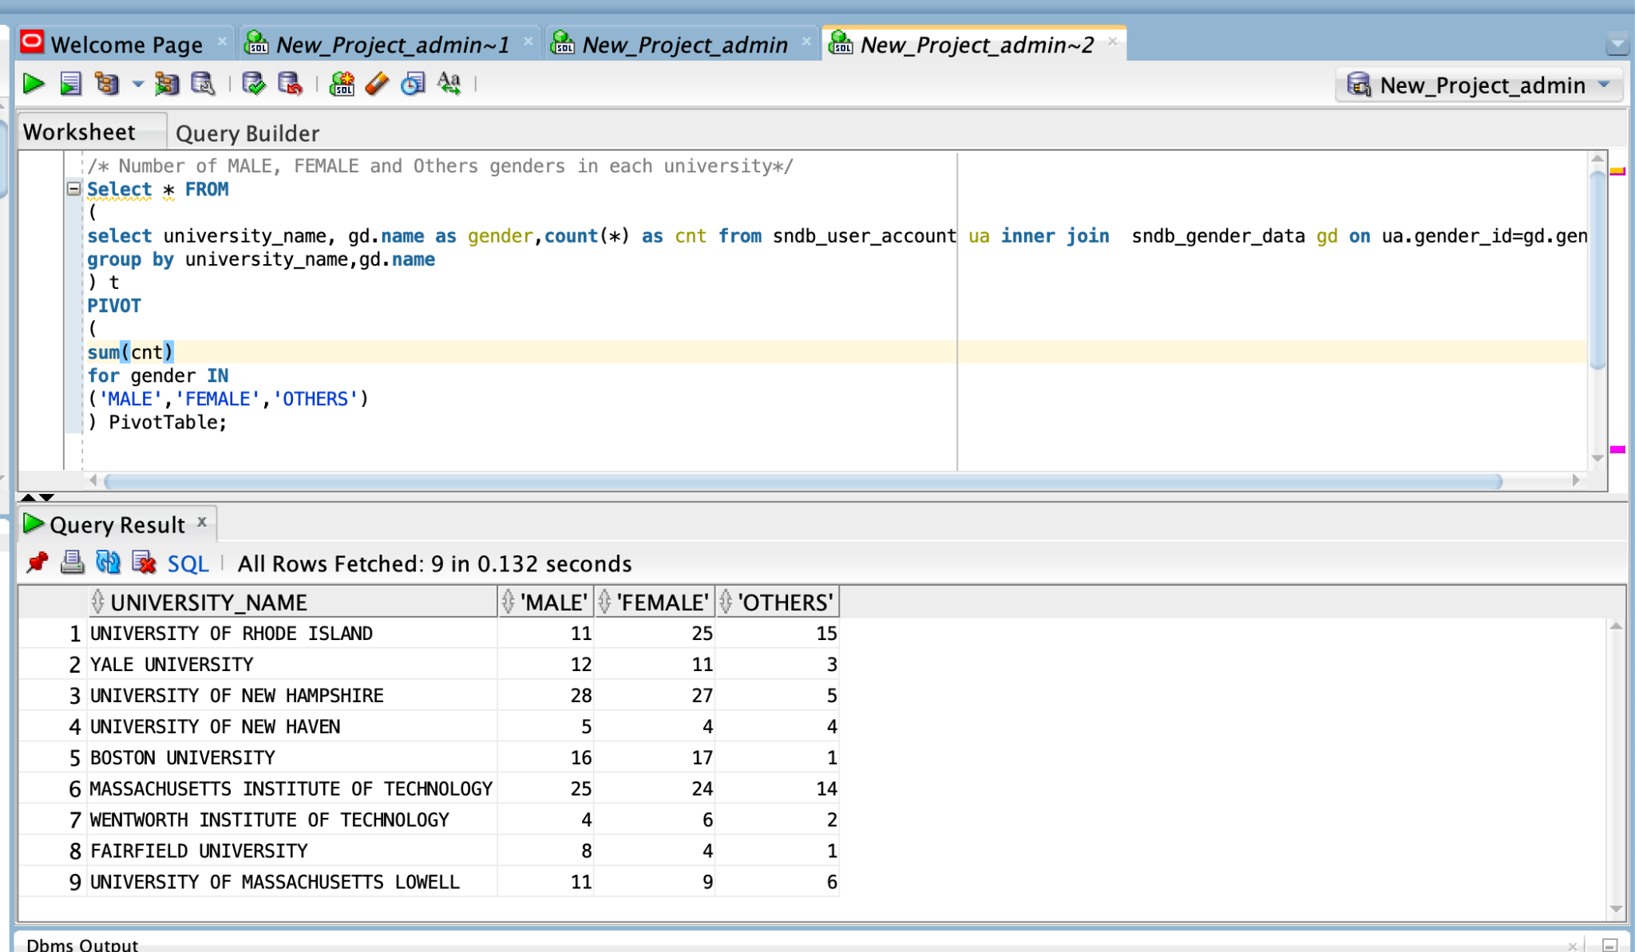
Number of MALE, FEMALE and Others genders in each university
Select * FROM
(
select university_name, gd.name as gender,count(*) as cnt from sndb_user_account ua inner join sndb_gender_data gd on ua.gender_id=gd.gender_id
group by university_name,gd.name
) t
PIVOT
(
sum(cnt)
for gender IN
('MALE','FEMALE','OTHERS')
) PivotTable;

Slide 19
Contributions
Sampada Dhole- Views creation, Security Part, Indexes, Procedures, Insertion Packages, Table creation, Views Update Proc
Meenakshi Vijay Kumbhar- Table initialization, insertion packages, insertion Procedure, Implement business logic rules, cursors, Views,Update View,Update procedure,Indexes, Chart reports,Triggers
Vishnuprasad Thopucharla- Table Creation, Insertion Packages, business logic inserts, Visualisation Reports, Documentation
Nikhitha Dasi Srinivas-Table initialization, insertion packages, insertion Procedure, Implement business logic rules, cursors, security
Shravya Vura-Table Creation,insertion packages, insert proc, business logic inserts, Reports.

Slide 20
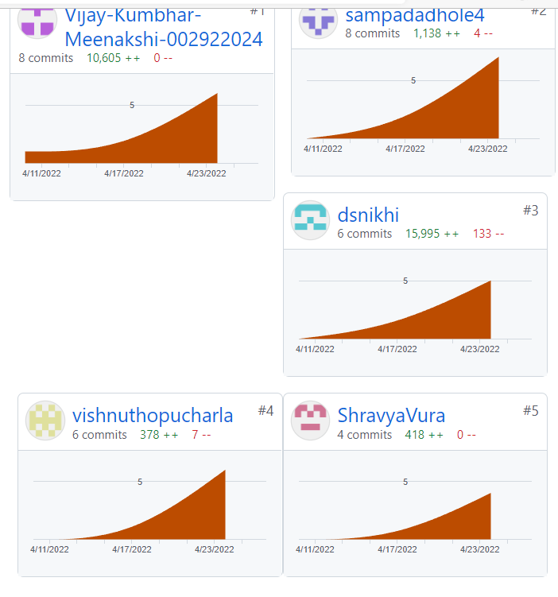
Git contributions

Slide 21
Thank you

